Slide 1
TLS and HTTPS
CSE 461 Section

Slide 2

A joke about bad weather

Slide 3
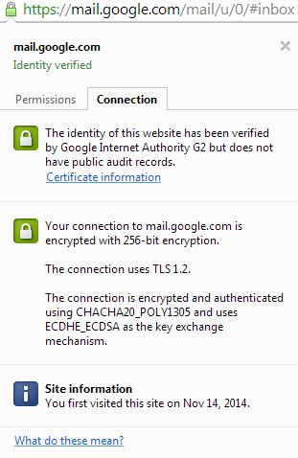

TLS Fundamentals
“Transport Layer Security” protocol
Standard protocol for encrypting Internet traffic
Previously known as SSL (Secure Sockets Layer), which has been around since 1994
TLS replaced SSL in 1999
Used for HTTPS (HTTP
Secure) traffic
Supported by nearly every
web browser

Slide 4
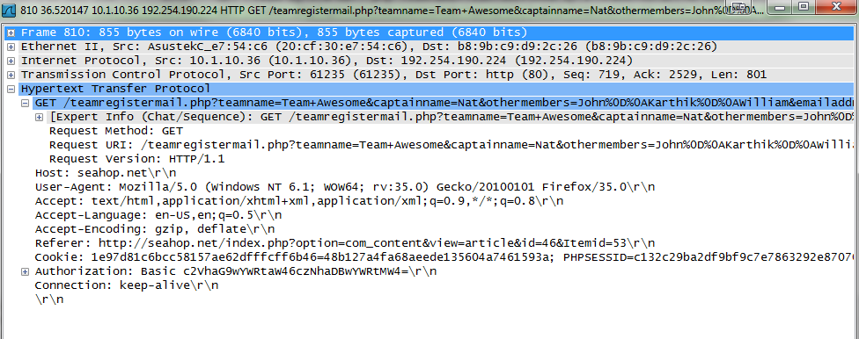
Purposes for TLS (1)
When we don’t use TLS, web traffic goes over unencrypted
This includes HTTP payloads, but also HTTP headers
Why are headers a problem too?

Slide 5
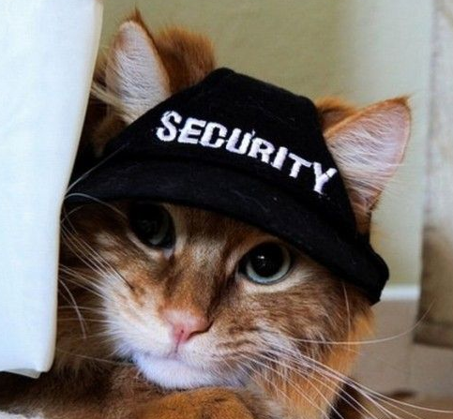
Purposes for TLS (2)
Data integrity
Server (and client) authentication

Slide 6
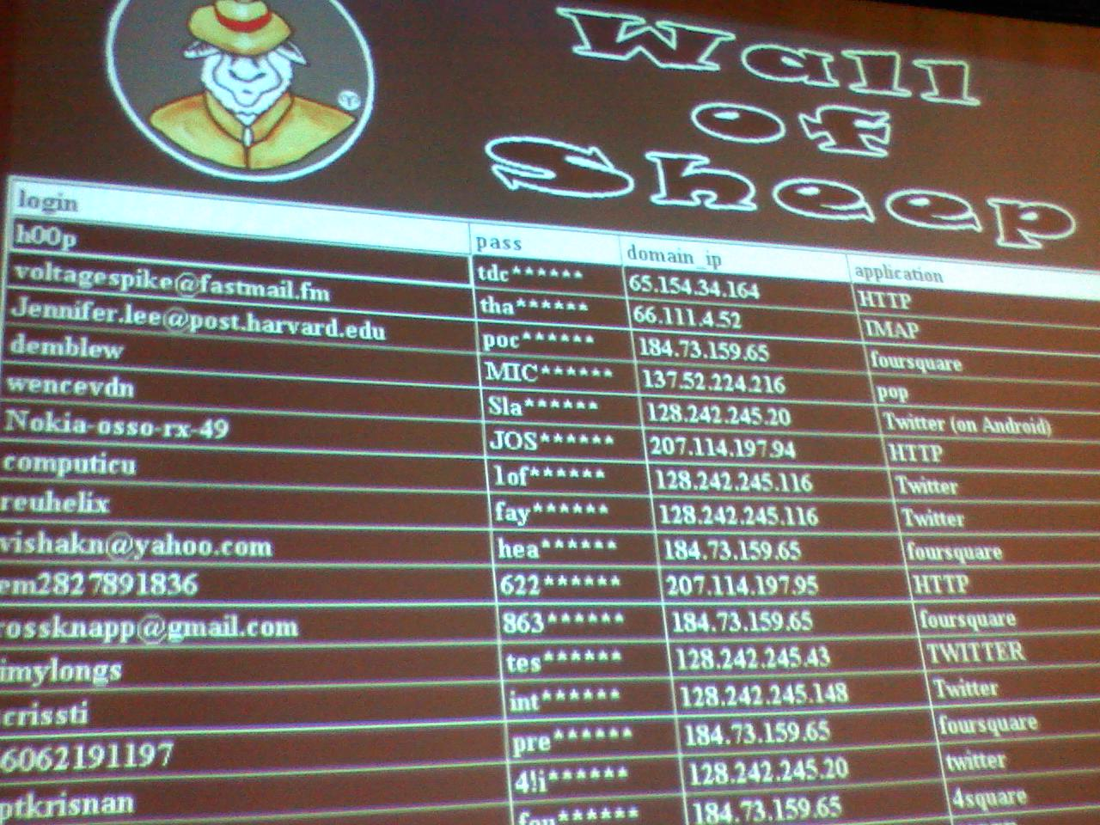
Defcon Wall of Sheep

Slide 7
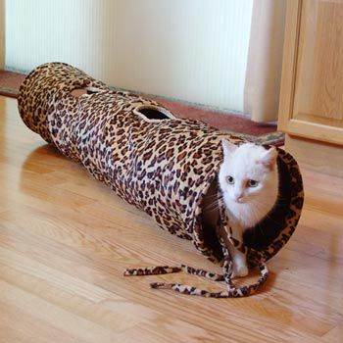
TLS and CONNECT
HTTP CONNECT is used to establish a two-way connection “tunnel” between two parties
After this, a “triple handshake” is performed over the tunnel
After the handshake, the two
parties can communicate securely
We’ll take a closer look at this
handshake

Slide 8
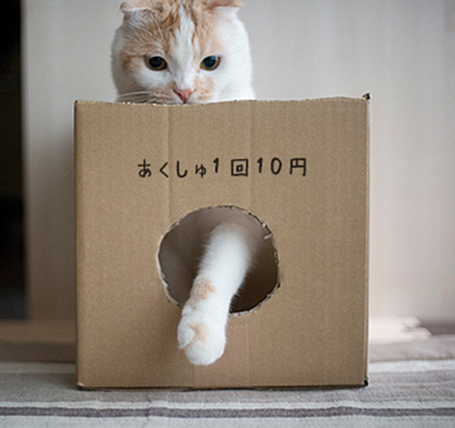
TLS Handshake Protocol (Concept)
What do we need to do to communicate securely?
  Make sure we’re speaking the same language
  Prove who we are
  Establish a secret code

Slide 9
TLS Handshake Protocol (Rough Details)
Client tells the server its protocol version and what cryptographic algorithms it can use
Server responds with a protocol version and cryptographic algorithm to use
Server sends its certificate to verify its identity
Client verifies certificate and sends Pre-Master Secret, encrypted so only the server can read it
Client and server both use that PMS to generate a Master Secret, which is used to generate encryption keys
Communication commences

Slide 10
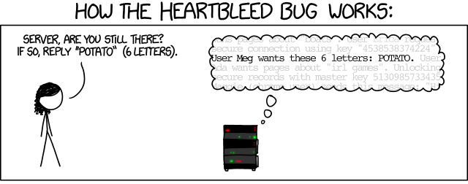
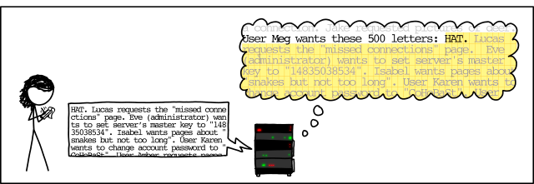
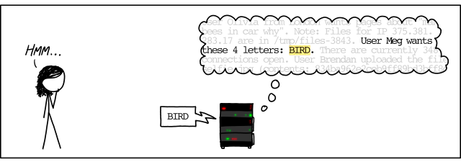
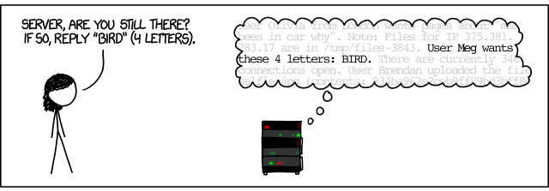
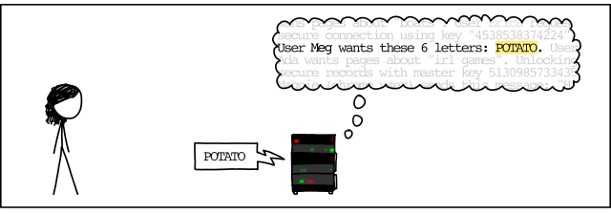
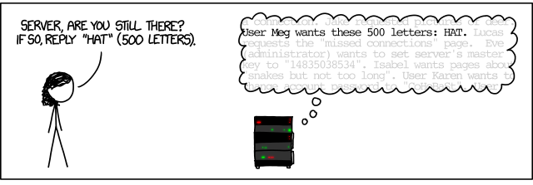
Heartbleed bug
2014 Bug in OpenSSL implementation of TLS
Clients ask for a “heartbeat” message to test and keep alive communication links
In OpenSSL, length checking wasn’t properly performed on the heartbeat data

Slide 11
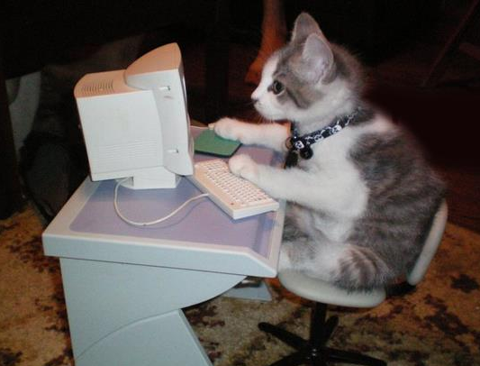
TLS Exploits
How might data be intercepted by a MITM, even when encrypted over TLS?
  Implementation bugs (e.g., Heartbleed, 3Shake)
  Server/browser attacks (e.g., truncation attack)
    “Truncate” logout packet from user
    User’s browser tells them
    they’ve logged out
    They haven’t
  Side-channel attacks

Slide 12

Side-channel TLS Attacks (1)
Some data is leaked even with encryption
  Packet send timing
  Payload size
  AJAX interfaces that load content dynamically provide insight into what the user is typing

Slide 13
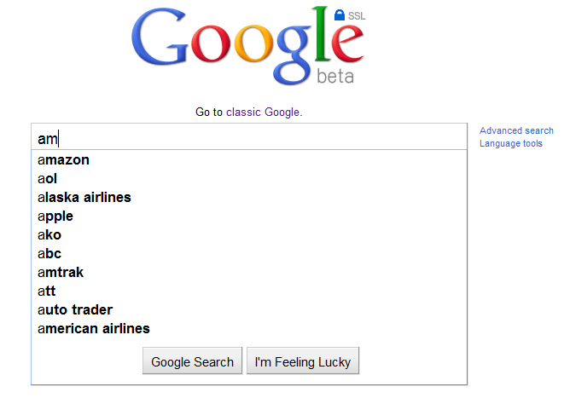
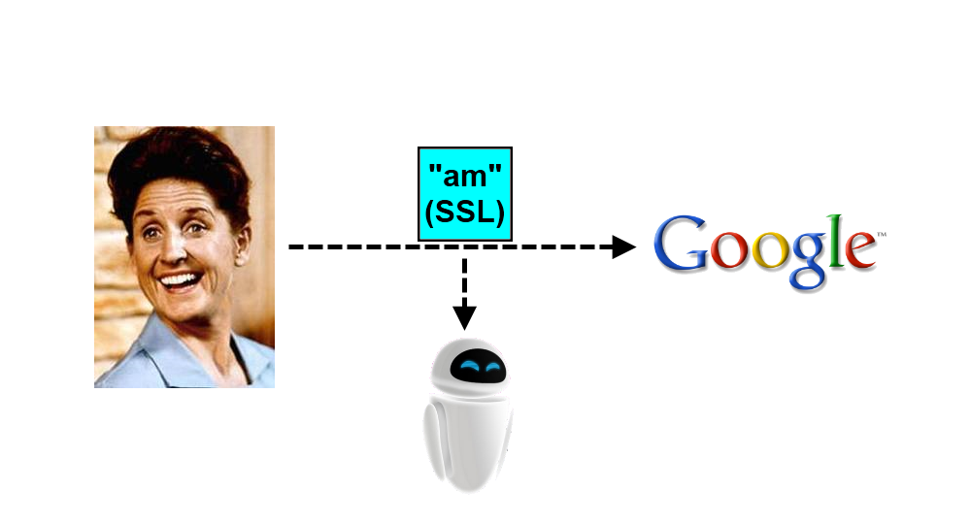
Side-channel TLS Attacks (2)

Slide 14
Autocomplete Packet Sizes for "hackers"

Slide 15
Autocomplete Packet Sizes for "benaloh"

Slide 16
Autocomplete Packet Sizes for "xvwqxzx"

Slide 17

Questions?

